Slide 1
TNB Club Membership
Project Kick-Off Meeting
Date: 22-02-2021

Slide 2
Project Description
There are 3 main clubs in TNB which are Kelab Kilat, Pelitawanis club and PKPI club. All these clubs have their own branches across TNB wide and are lead by the Headquarters (HQ) level. Currently, all the membership being stored and monitored manually and the current method is not convenient. Thus, Group Corporate Communication is requesting a single repository and platform to store club membership information.
All 3 Clubs Membership information are stored in a Microsoft Access database that resides in a standalone PC. The yearly club’s budget is allocated based on the number of memberships in the particular office location.
For Kelab Kilat situation, any staff movement to the new office location, it needs to be recorded and keep tracked manually by the Kelab Kilat PIC. Sometimes, staff’s office location is not updated and it caused difficulty for PIC’s to track the accurate number of Kelab Kilat member in that particular location.

Slide 3
Project Objectives and Benefits
To improve current process by implementing a system that handles online registration with approval workflow and storage of membership information
Benefits
Consolidation of information and data in a single platform
Transparent process for better monitoring
Improve time taken for data analysis
Single source of truth
Membership information is available online

Slide 4
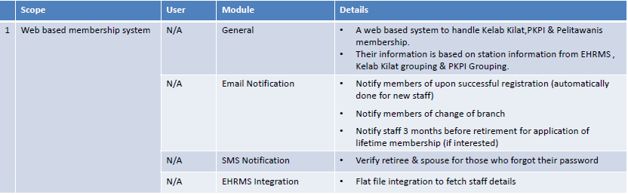
Project In Scope and Out of Scope
Project Includes

Slide 5
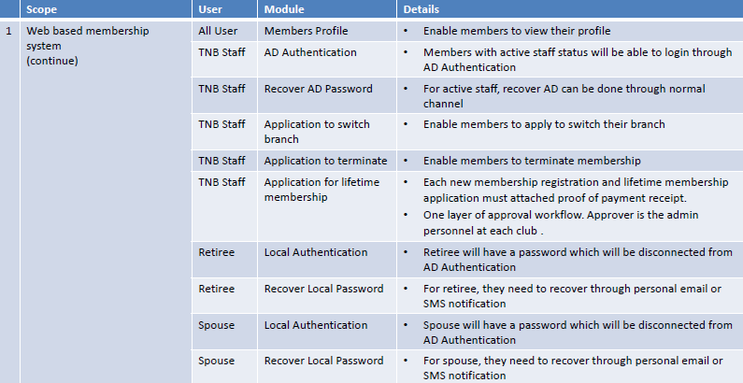
Project In Scope and Out of Scope

Slide 6
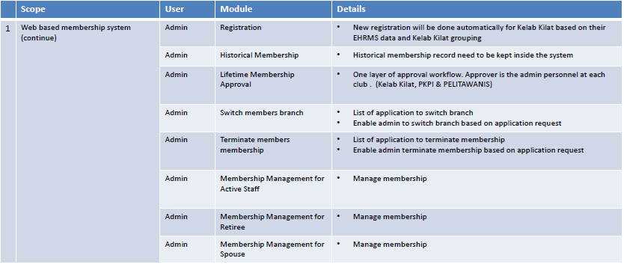
Project In Scope and Out of Scope

Slide 7
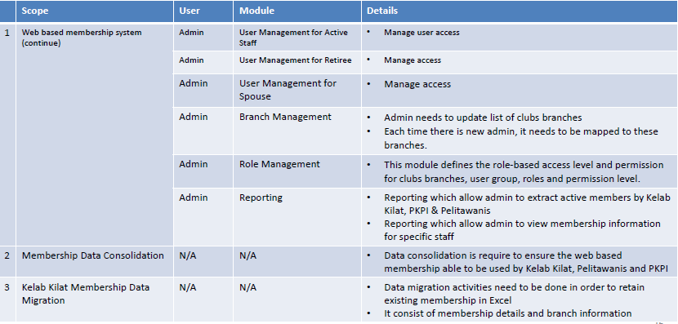
Project In Scope and Out of Scope

Slide 8
Project In Scope and Out of Scope
System Integration
Number | Module | Integration Description
1. | Active Directory | User login credentials authentication and authorization with TNB Active Directory
2. | EHRMS | Flat files EHRMS integration
3. | SMS | User account verification

Slide 9
Project In Scope and Out of Scope
Project Excludes
No | Item
1. | Additional major requirement that not explicitly stated in the proposal that might be impacted the workflow, structure and system based. It will lead towards the delay of the deliverable for the project and will incur the additional resources/timeline/cost. For this cases, assessment need to conduct and potentially will be catered as a Change Request

Slide 10
Project Assumptions and Dependencies
Assumptions
Provide timely access to relevant information (existing reports, related system documents), as well as appropriate resources required to complete the project.
Sufficient access to appropriate levels of management to facilitate the gathering of requirements for the various stages of the project.
On-going requirement refinement, review and approval are, historically, the biggest risk in meeting these objectives.
Appoints a Point-of-Contact to work for planning activities. In most cases, this is the client coordinator.
System Platform will be designed and developed based on a typical project delivery following best practices.
Dependencies
Limited In-house resources and divided commitments between all on-going projects.
Timeliness of input, review, feedback and approval from Group Corporate Communication project team will affect ICT project team actions.

Slide 11
Critical Success Factors and Constraints
Critical Success Factors
Project Manager should endeavour to elicit commitment from the project team members and all stakeholders.
Project Sponsor from Business is major key to the project on deciding on organisational and project strategy as well as performing goal setting functions within the unit and department.
Project goals and deliverables are specific, measurable, attainable, relevant and time-bound (using SMART principle).
An agreed upon process for the quick identification and resolution of any conflicts during project phase.
Good communication between Project Manager and Coordinator. Best practices should be applied at every phase of the project in ensuring successful deliverables.
Proper risk management policies and risk mitigation must be established from to prevent delay of the project.
Proper project planning and planning procedures in place. Critical in keeping the project organised.
Constraints
System will be developed on .Net platform.
No out-tasker ICT vendor will be involved in this project.
ICT will develop the system using in-house development. There will be some factors affecting the project duration:
Requirements changes along the development phase by Project Sponsor and Team.
Commitment and priority on simultaneous on-going projects by the assigned developer that potentially impact project delivery.

Slide 12
Critical Success Factors and Constraints (cont.)
The project will be determined successful if the system developed is accessible and working as expected according to features and functionality documented in User Requirements Specification (URS).
Meet the requirements defined and agreed as per documented in the User Requirements Specification (URS).
Perform testing:
Unit Testing (development phase)
System Integration Testing (execution phase)
User Acceptance Test (UAT)
Conduct training and transfer of technology sessions for GCC/GHR Admin upon User Acceptance Test (UAT)
Provide support and maintenance to the system

Slide 13
Project Oversight Authority
The Project Manager will be responsible for all project planning, execution, and the coordination of all project activities and resources. The Project Manager will manage the project in accordance with Project Management Book of Knowledge (PMBOK) Project Management Methodology (PMM).
All approval and feedbacks related to the project decision and progress will be referred and circulated to the Project Sponsor. The information will then be cascaded to all stakeholders.

Slide 14
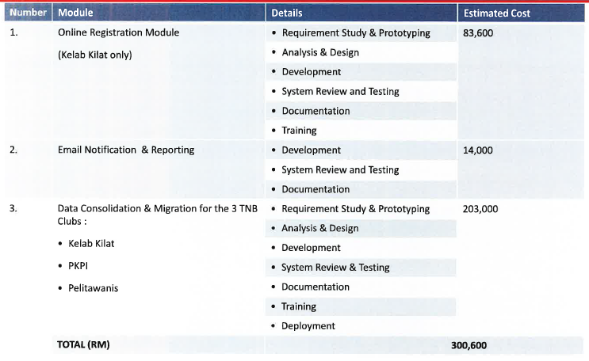
Project Cost
Project to be developed in-house by ICT
Should any additional requirement/changes required to be identified at a later stage, the Project Manager will initiate a Project Change Request form - to be approved by the Project Sponsor.

Slide 15
Project Structure
Project Director
Nor Saiful Zaini b Nasiruddin
Wan Amizan Wan Yunus
Project Working Committee
Career Enhancement Management Team
Project Coordinator (SME)
Khairulbahar bin Taib
Ali Aswan Bin Sha'Arani
Muhammad Feizal b. Abu Kassim
ICT Project Manager
Shamsul Azam Muhamad
Technical/Development Team
ICT Corporate Solution Advisory Delivery
Scrum Master/Lead Developer: Shukri
UIUX Designer: Syikin
UIUX Developer: Syikin
DevOps Engineer: Zhafri
Front End Developer: Ghashirin
Database Developer: Raihan
Consolidation Developer: Fauzatul Mimi
Business Partner
Nur Syahidah Sobri
Requirement Engineer
Nor Azura Mohamed Salim
Project Solution Architect
Nadzirah bt Ahmadi
Project Sponsor (Corporate Affairs - GCC)
Datuk Omar Sidek
Wan Hairul Razli Ahmad Kushaari

Slide 16
Roles and Responsibilities
Role | Responsibility
Project Sponsor | The Project Sponsor is the client side representative who provide funding to the project. Responsibilities include: Authorising the provision of funds / resources (internal or external)
Project Director | The Project Director is the client side representative who acts as a single focal point of contact with the project manager for the day-to-day management of the interests of the project. Project Sponsor has an adequate knowledge and information about the business and the project to be able to make informed decisions. Responsibilities include: Defining the vision and high level objectives for the project Approving the requirements, timetable, and resources Ensuring that major business risks are identified and managed Approving any major changes in scope
Project Manager | The Project Manager is the individual responsible for delivering the project. The Project Manager leads and manages the project team, with the authority and responsibility to run the project on a day-to-day basis. Responsibilities include: Review all the critical project deliverables. Participate in and contribute to the progress meetings and bring the key project issues to the attention of the project team members Advise the Project Sponsor on any corrective actions to be taken with respect to the modification of the project plan and project deliverables; Ensuring that all required resources are assigned to the project and clearly tasked according to the defined scope of the project Monitoring and reporting on project performance (quality and risk) Reporting and escalating project risks and issues Managing project interdependencies Making adjustments to the detailed plan as necessary to provide a complete picture of the progress of the project at any time.

Slide 17
Roles and Responsibilities (cont.)
Role | Responsibility
Requirement Engineer | The Requirement Engineer is the individual who has the responsibility to elicit, analyze, specify, verify, and manage the real needs of the project stakeholders, including the end users. The Requirement Engineer serves as the conduit between the client and the software development team through which requirements flow. Responsibilities include: Work with the Project Manager and/or Project Sponsor to document the product’s vision and the project’s scope. Elicit requirements using interviews, document analysis, requirements workshops, storyboards, site visits, business process descriptions, use cases, scenarios, event lists, business analysis, competitive product analysis, task and workflow analysis, and/or viewpoints. Write requirements specifications according to standard templates, using natural language simply, clearly, unambiguously, and concisely. Decompose high-level business and user requirements into functional requirements and quality, according to final requirement as agreed by user. Participate in peer reviews of work products derived from requirements specifications to ensure that the requirements were interpreted correctly.
Development Team | The Development Team creates user information solutions by developing, implementing, and maintaining applications solution with guidance from the Lead Development. Responsibilities include: To adhere to the product quality standards and principles agreed by the project team and client, as well as with the wider development team. Demonstrate understanding and development in producing the solutions according to client’s requirements. Leverage on available knowledge and resources with guidance from the Lead Development.
Project Working Committee | The Project Working Committee provides oversight on Project and advises on project scope, objective and timelines and allocate resources accordingly.

Slide 18
Project Risks and Issues
# | Risk Description | Risk Category | Mitigation | Due Date | PIC | Remarks
1. | Project scope is not being identified thoroughly in Detailed Requirements. | Medium | To confirm on the project scope during System Requirement Study so that the actual requirement from user can be achieved. | TBA | User, Development Team
2. | System Admin does not have sufficient knowledge on navigating and administrating the System. | Low | Conduct user and admin training before System Go-Live and a refresher training if required post Go-Live. | TBA | Trainer
3. | Availability of key personnel (client and development team) during clarifications and confirmation of Application design and layout. | Medium | Plan ahead on the meeting/discussion between both client and development team and follow-up with written documentation in email for distribution to all stakeholders. | TBA | PM, User, Development Team
# | Issue Description | Issue Category | Resolution | Due Date | PIC | Remarks
★ Risk Categories are Low, Medium, Significant and High
✦ Issue Categories are Internal and External

Slide 19
Project Implementation Schedule
Milestone | Baseline Start Date | Baseline Finish Date
Project Kickoff Meeting | 22 February 2021 | 22 February 2021
Analysis and Design | 22 February 2021 | 24 March 2021
Portal Build/Development – In Sprints | 25 March 2021 | 10 June 2021
Perform Testing | 11 June 2021 | 21 June 2021
Perform UAT | 22 June 2021 | 24 June 2021
User Training | 8 July 2021 | 13 July 2021
Deployment and Go-Live | 14 July 2021 | 26 July 2021
Project Closure | 27 July 2021 | 6 August 2021
Deliverable | Baseline Start Date | Baseline Finish Date
Project Charter | 22 February 2021 | 1 March 2021
Project Plan | 22 February 2021 | 1 March 2021
Release and Deployment Plan | 2 March 2021 | 15 March 2021
Requirements Document | 22 February 2021 | 24 March 2021
Detailed Design Document | 15 March 2021 | 24 March 2021
Test Completion Report | 11 June 2021 | 24 June 2021
Service Handover Report | 8 July 2021 | 26 July 2021
Project Closure Report | 27 July 2021 | 6 August 2021

Slide 20
Project Implementation Schedule
Milestone/Deliverable | Planned Start Date (dd/mm/yyyy) | Planned Finish Date (dd/mm/yyyy)
Execution
Sprint 1 Development of Kelab Kilat Module & Release | 25 March 2021 | 9 April 2021
Sprint 2 Development of PKPI Module & Release | 12 April 2021 | 30 April 2021
Sprint 3 Development of Pelitawanis Module & Release | 3 May 2021 | 21 May 2021
Sprint 4 Data Consolidation for Kelab Kilat, Pelitawanis & PKPI and Reporting Module Release | 24 May 2021 | 10 June 2021

Slide 21
THANK YOU

